Slide 1
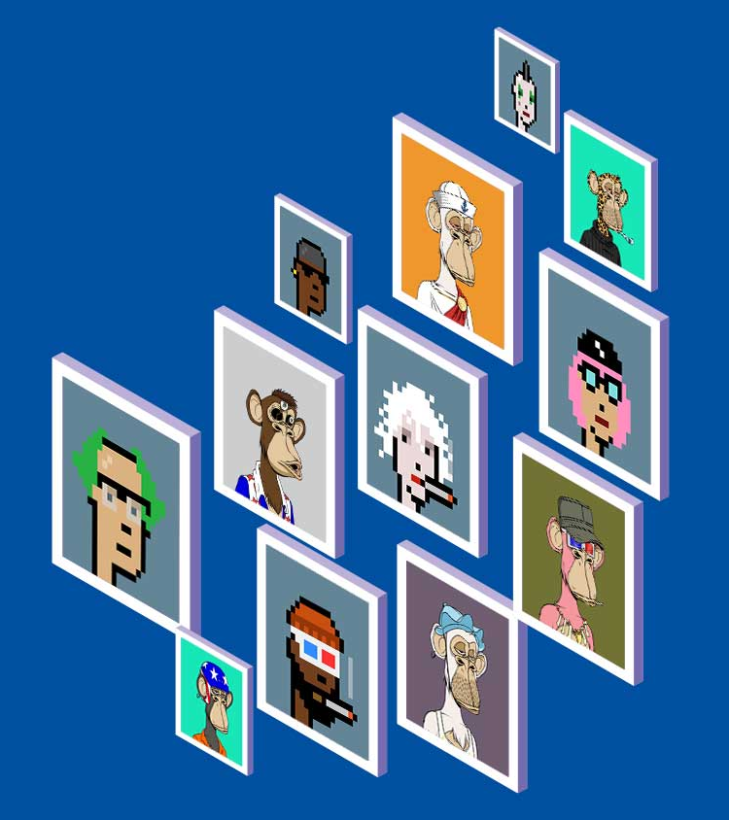
NFT Marketplace
using Blockchain
NFTs
By Group 19 Members
SOUMYAK MITRA
ANUBHAV ROUTH
SAYAK KARUI
ARPAN BASU
Under the guidance of
Amartya Chakraborty

Slide 2
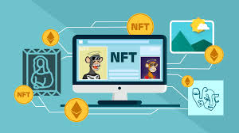
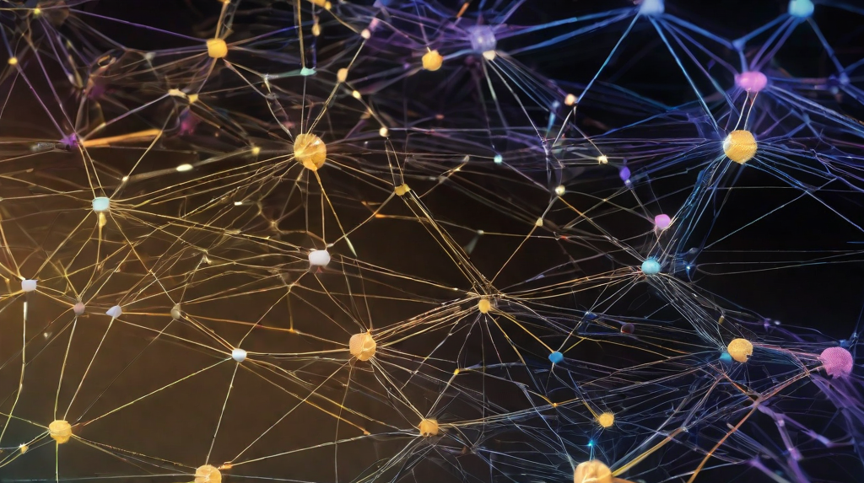
Introduction to NFTs
NFTs, or non-fungible tokens, are a type of digital asset that represent ownership of a unique item or piece of content. They are stored on a blockchain network, which ensures their authenticity and prevents duplication or alteration.
NFTs have gained significant attention in the art market, as they allow for the sale and ownership of digital artwork. This has opened up new opportunities for artists and collectors alike, as it provides a way to monetize digital art and ensures its authenticity and provenance.

Slide 3
NFT Marketplaces vs Traditional Makerplaces
Traditional Makerplaces
Traditional makerplaces are platforms that allow creators to sell their products directly to consumers. These platforms typically charge a commission on each sale and may have limited features for managing inventory and orders.
NFT Marketplaces
NFT marketplaces use blockchain technology to create a decentralized platform for buying and selling digital assets, such as art, music, and collectibles. These marketplaces typically charge a commission on each sale and may offer additional features for managing inventory and orders.
Key Differences
NFT marketplaces use blockchain technology, which provides a secure and transparent way to manage digital assets.
NFT marketplaces typically offer additional features for managing inventory and orders, such as smart contracts and automated payments.
NFT marketplaces may have a smaller commission rate than traditional makerplaces, as they do not need to pay for physical inventory or shipping.

Slide 4
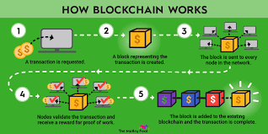
How Blockchain Technology Works
Blockchain technology is a decentralized, digital ledger that records transactions on multiple computers in a secure and transparent way. Each block in the chain contains a number of transactions, and every time a new transaction occurs, it is added to the chain and verified by a network of computers. Once verified, the transaction becomes a permanent part of the blockchain, and it cannot be altered or deleted.
The relevance of blockchain technology to NFTs lies in the fact that NFTs are essentially digital assets that need to be verified and authenticated. By using blockchain technology, NFT marketplaces can ensure that each NFT is unique and cannot be duplicated or replicated. Additionally, blockchain technology allows for secure and transparent transactions, which is crucial for the buying and selling of NFTs.

Slide 5
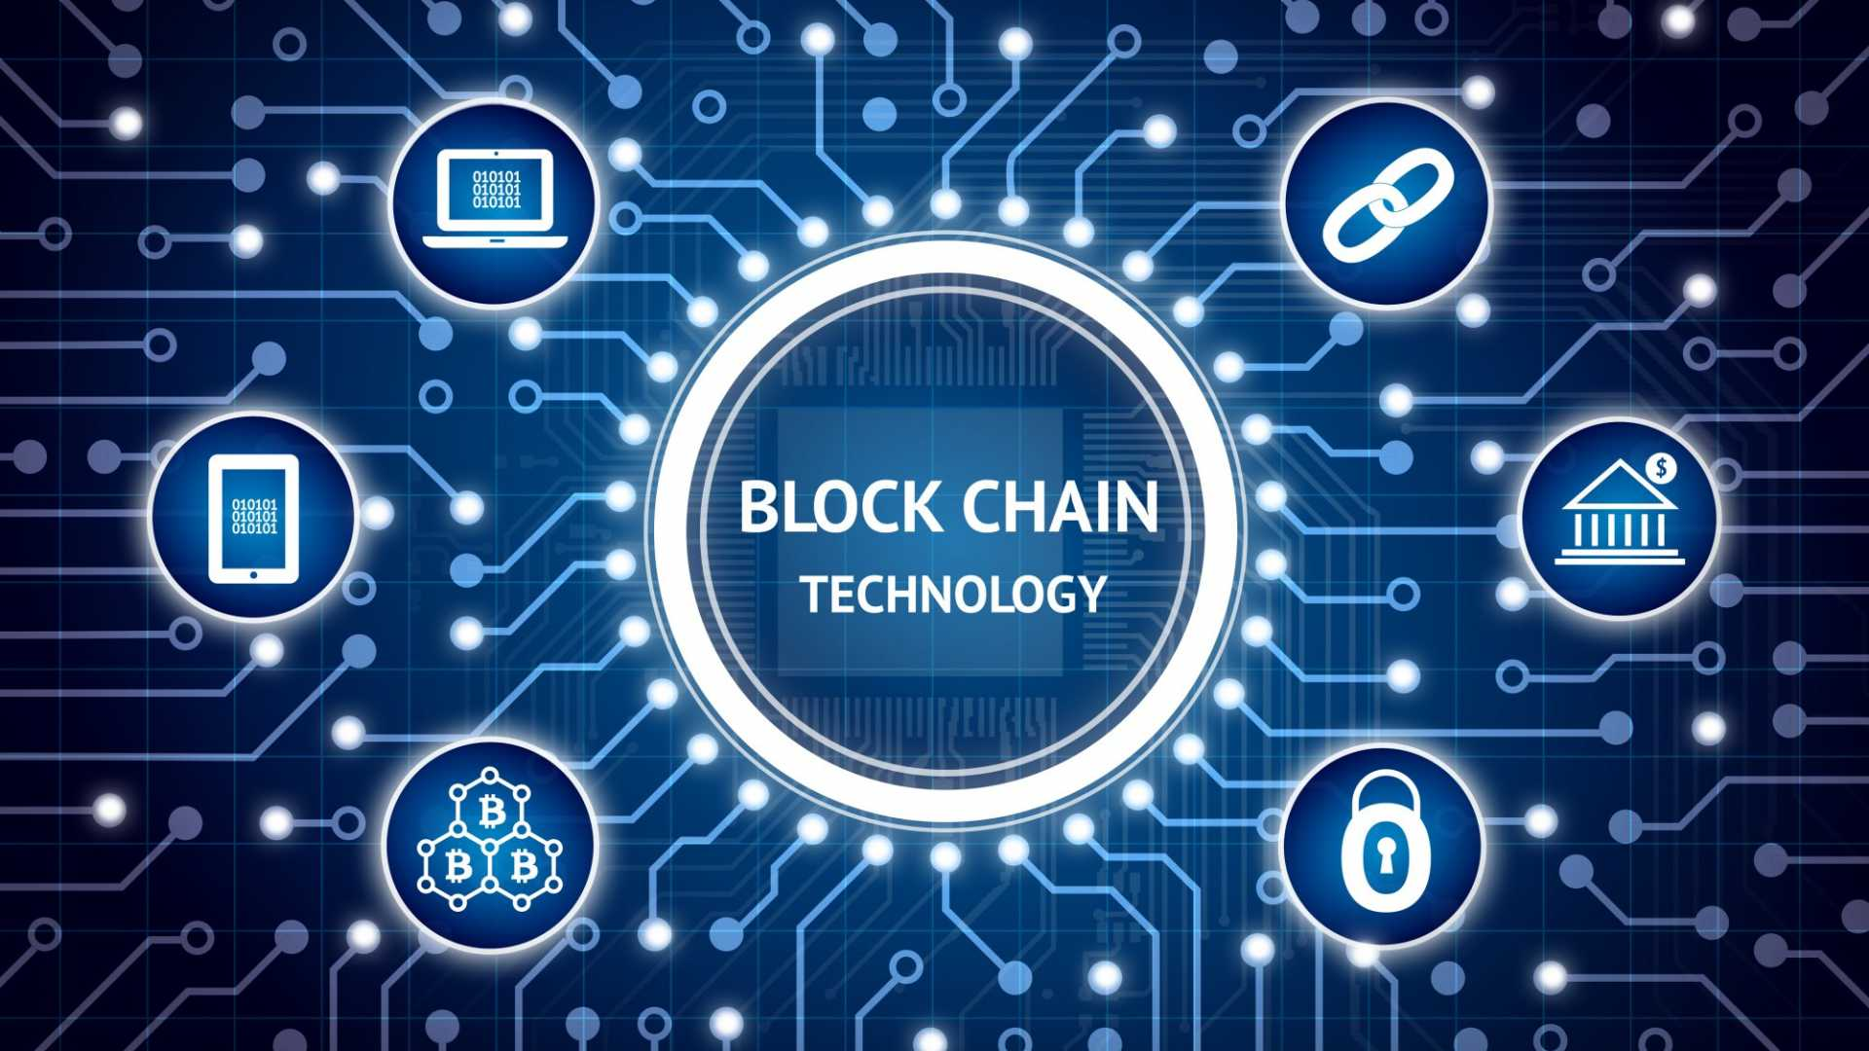
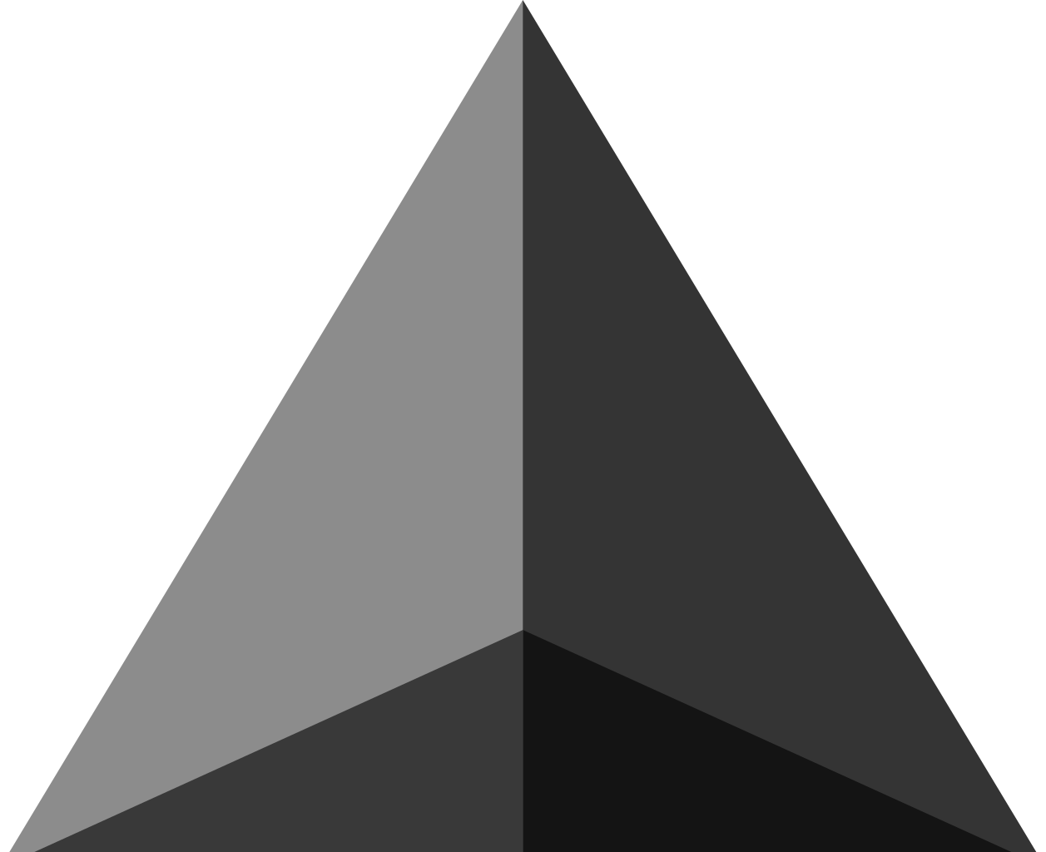
Ethereum in Blockchain
NFTs and Ethereum
NFTs are unique digital assets that are stored on a blockchain and can represent anything from art to music to collectibles. Ethereum's smart contracts make it possible to create and trade NFTs in a decentralized and transparent way.
The NFT marketplace has exploded in recent years, with sales of NFTs reaching millions of dollars. Ethereum's smart contracts have played a key role in this growth, enabling the creation and trading of NFTs in a secure and transparent way.
Ethereum and Blockchain
Ethereum is a decentralized blockchain platform that enables the creation of smart contracts and decentralized applications (dApps). It was launched in 2015 and has since become one of the most popular blockchain platforms in the world.
Ethereum's smart contracts allow for the creation of decentralized applications that can be used for a variety of purposes, including the creation and trading of non-fungible tokens (NFTs).

Slide 6
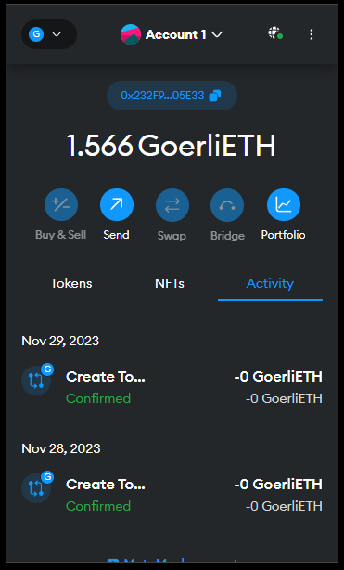
Using MetaMask Wallet as a Provider in Dapps
Optimizing Gas Price
To optimize gas price when using MetaMask wallet as a provider in dapps, follow these steps:
Ensure that your Metamask wallet is connected to a reliable network with low transaction fees.
Use a gas price estimator tool to determine the optimal gas price for your transaction.
Adjust the gas price in your dapp's contract to match the estimated gas price.

Slide 7
Solidity and Smart Contracts in NFT Marketplaces
Solidity is a programming language used to write smart contracts, which are self-executing contracts with the terms of the agreement between buyer and seller being directly written into lines of code. Smart contracts are an essential component of NFT marketplaces, as they enable the creation and transfer of unique digital assets in a secure and transparent way.
Role of Solidity and Smart Contracts in NFT Marketplaces
Solidity and smart contracts play a crucial role in NFT marketplaces by providing a secure and transparent way to create, transfer, and own unique digital assets. Smart contracts enable the creation of unique digital assets, such as art, music, and collectibles, that are stored on a blockchain and can be bought, sold, and traded like any other asset.
Solidity is used to write the code for smart contracts, which are then deployed on a blockchain. This ensures that the terms of the agreement between buyer and seller are directly written into the code, making it impossible for anyone to alter or manipulate the contract once it has been deployed. This level of transparency and security is essential for NFT marketplaces, as it ensures that all transactions are legitimate and that the ownership of digital assets is clearly established.

Slide 8
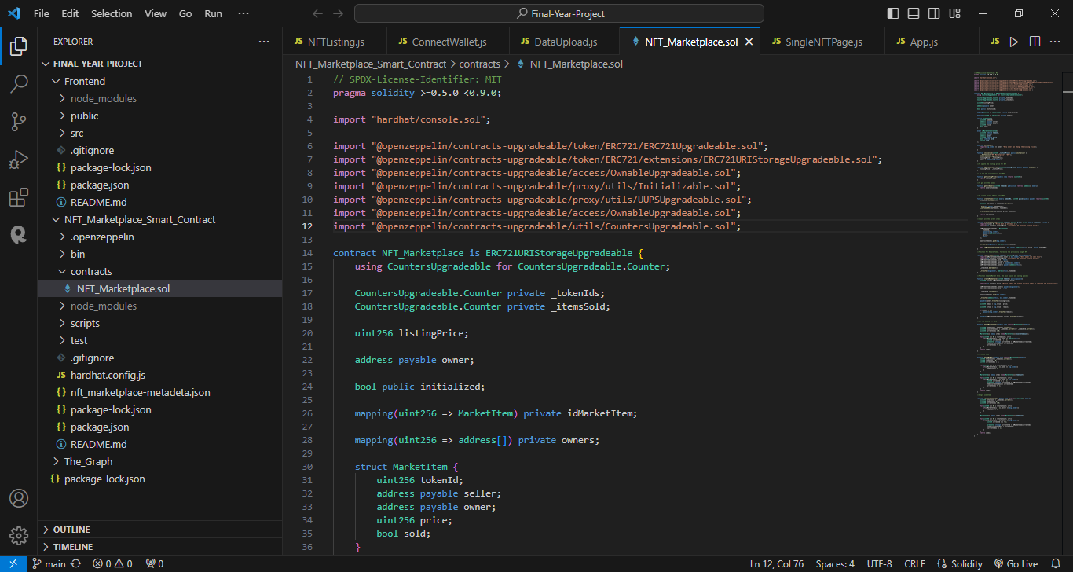
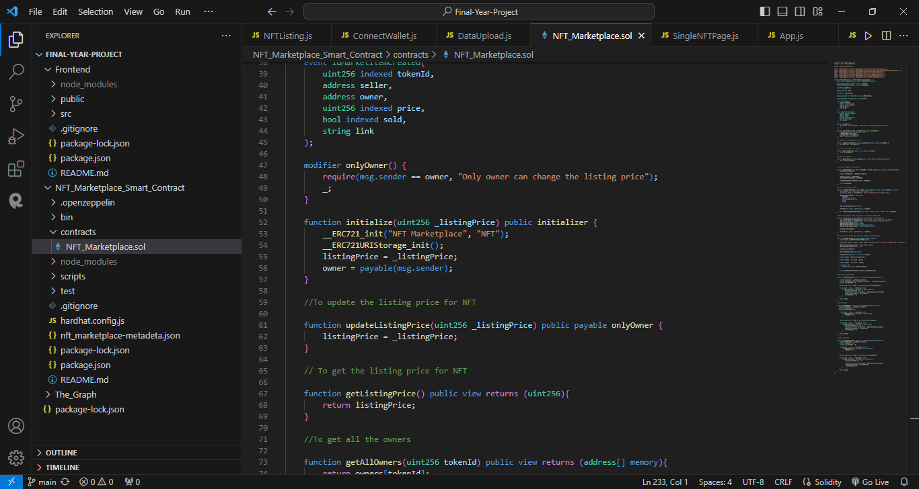
Contracts of NFT MarketPlace :

Slide 9
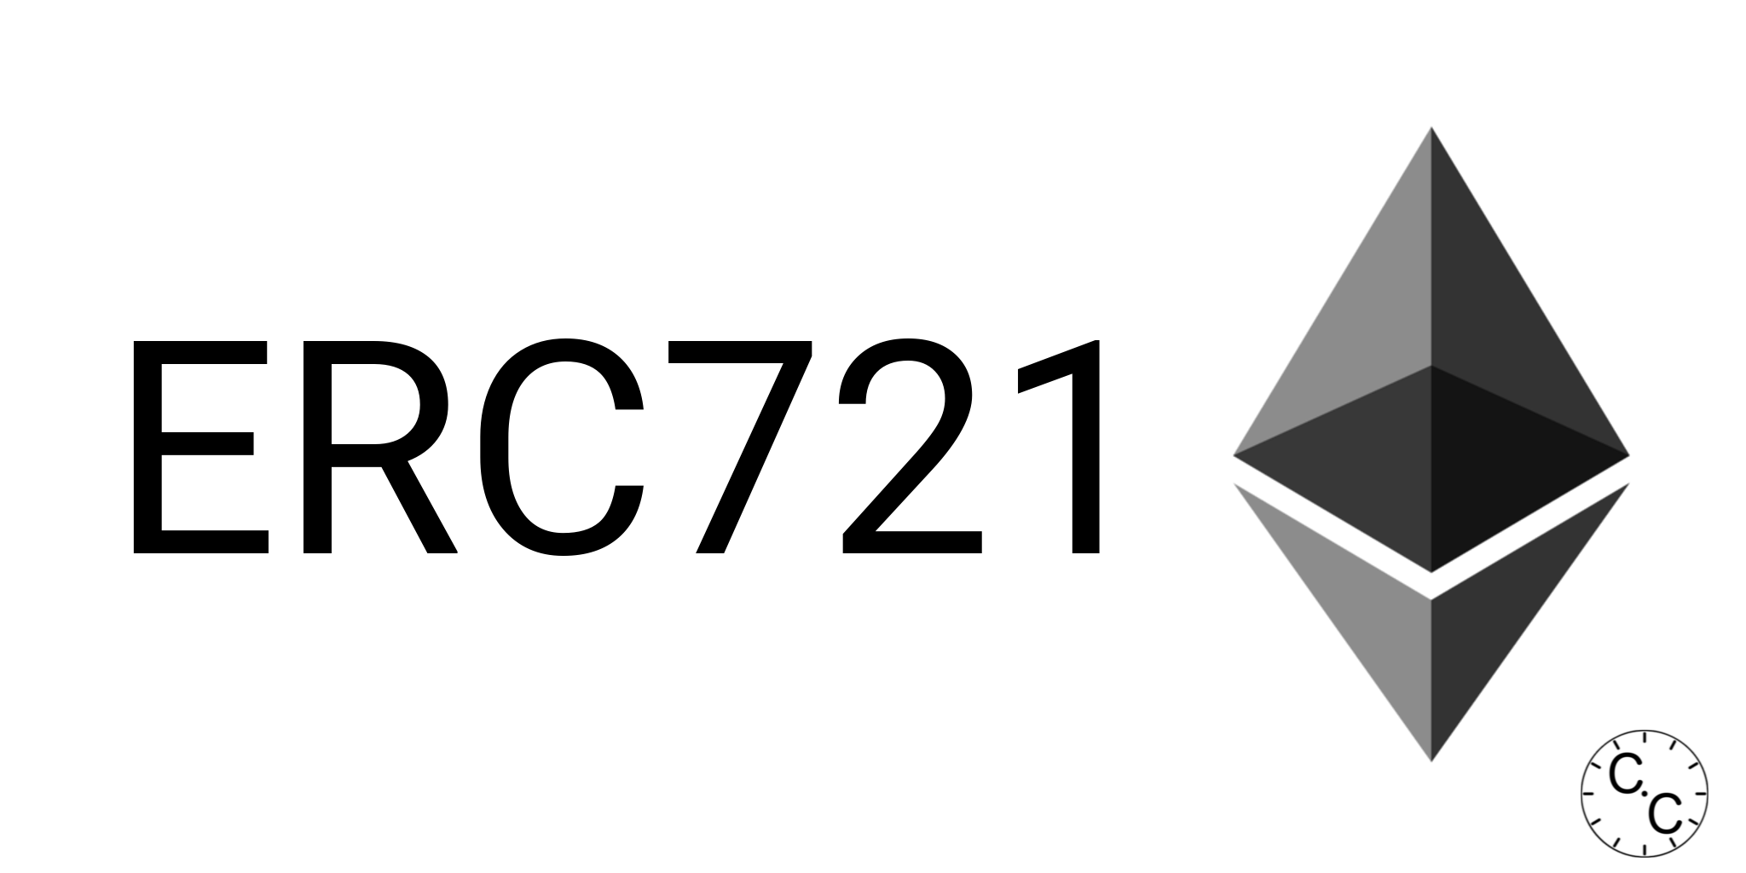

ERC721 Tokenformat
Potential Applications
Art and Collectibles: ERC721 tokens can be used to represent unique digital artwork or collectibles, such as rare digital cards or virtual real estate.
Real-World Assets: ERC721 tokens can also be used to represent ownership of real-world assets, such as property or vehicles, providing a new way to buy, sell, and trade these assets.
What is ERC721 Tokenformat?
ERC721 Tokenformat is a standard for creating unique and valuable digital assets on the Ethereum blockchain. It allows for the creation of non-fungible tokens (NFTs) that can represent anything from artwork to collectibles to real-world assets.

Slide 10
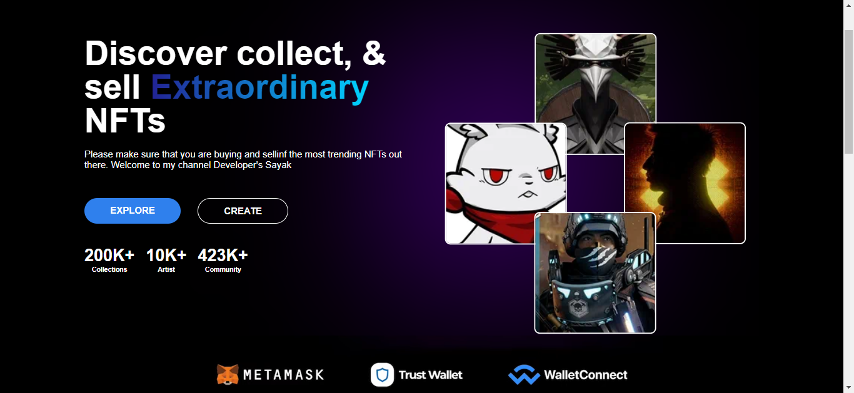
Benefits of NFTs for Artists and Collectors
NFTs (Non-Fungible Tokens) have revolutionized the art world by providing a secure and transparent way to buy, sell, and trade digital artwork. Both artists and collectors can benefit from the use of NFTs.
Benefits for Artists
NFTs provide a way for artists to monetize their digital creations in a way that was not possible before. By creating unique and verifiable digital assets, artists can sell their work directly to collectors without the need for intermediaries like galleries or auction houses.
NFTs also provide a way for artists to maintain control over their work. They can set the terms of the sale, including the price and any royalties they wish to receive from future sales.

Slide 11
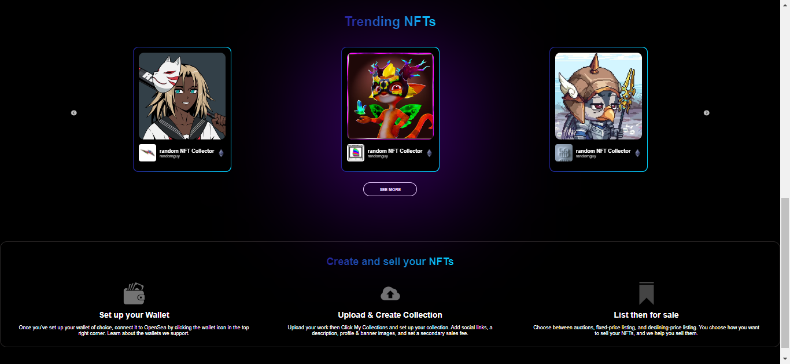
Benefits for Collectors
For collectors, NFTs provide a way to own and trade unique digital assets that are verified on the blockchain network. This ensures that the asset is authentic and cannot be duplicated or counterfeited.
NFTs also provide a way for collectors to invest in emerging artists and support their work. By purchasing an NFT, collectors can directly support the artist and potentially profit from future sales of the asset.

Slide 12
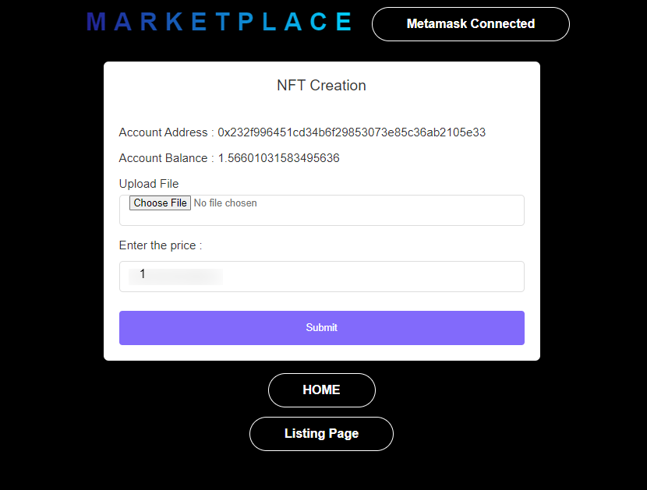
How Our Marketplace Works
Our marketplace is a unique platform that utilizes blockchain technology to ensure secure and transparent transactions for buying and selling NFTs. Here's how it works:
Create an Account
To use our marketplace, users must first create an account. This allows them to buy and sell NFTs, track their transactions, and manage their digital assets.
Browse and Buy NFTs
Once logged in, users can browse the marketplace for NFTs they are interested in. They can filter by category, artist, price, and other criteria to find the perfect NFT for their collection. When they find an NFT they want to purchase, they can buy it using our secure and transparent payment system.

Slide 13
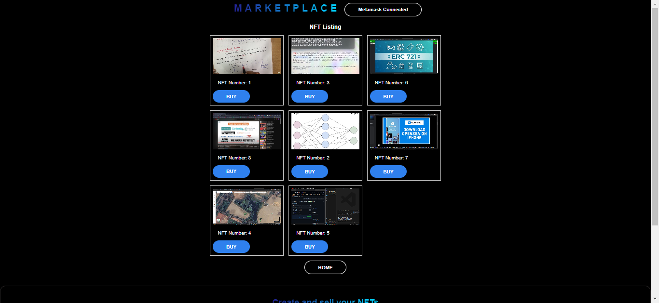
Sell Your NFTs
Our marketplace also allows users to sell their own NFTs. They can create a listing, set a price, and wait for interested buyers to make an offer. When a sale is made, the seller receives payment instantly and securely through our payment system.
Unique Features
Our marketplace has several unique features that set us apart from other NFT platforms. These include:
Secure and transparent payment system using blockchain technology
Ability to sell your own NFTs and set your own prices
Easy-to-use interface for browsing and buying NFTs

Slide 14
Auction System in NFT Marketplace
Auctioneer: have more control over the sale process, setting the starting bid, an optional reserve price, and the auction duration. The reserve price, if set, acts as a hidden minimum the seller hopes to achieve. If bids fail to reach this threshold, the auction fails, protecting the seller from undervaluing their NFT.
Bidders: actively engage in the bidding process, strategically placing bids to outcompete others. They can monitor the current highest bid and the number of participants, gauging competition and adjusting their strategy accordingly.
Time period: The time period of the auction can be decided by the owner of the NFT, as per their choice.
Transparency: Our application provides clear information about the auction process, fees, and seller policies. This includes disclosing reserve prices (if applicable) to avoid misleading buyers.
Transaction fees: Our application charge fees for listing NFTs, placing bids, and successful transactions. Understanding these fees and factoring them into your bidding strategy is crucial.
Volatility: Unlike fixed-price listings, bid prices in auctions can fluctuate significantly throughout the process. This volatility can make it challenging to predict the final outcome and requires a degree of risk tolerance from participants.

Slide 15
Recommendation System in NFT Marketplace
Content-based filtering: This approach analyzes the NFT's features (e.g., artist style, metadata, associated community) to recommend similar ones to users who liked similar NFTs in the past. However, relying solely on content might overlook the investment aspect.
Collaborative filtering: This method considers user-to-user interactions, recommending NFTs popular among users with similar tastes or past purchase history. This can address the investment aspect but might be hindered by data sparsity.
Hybrid approaches: Combining content-based and collaborative filtering can leverage the strengths of both, offering more comprehensive recommendations. Additionally, incorporating multi-modal attention techniques can analyze user preferences for different NFT features, leading to more personalized suggestions.

Slide 16
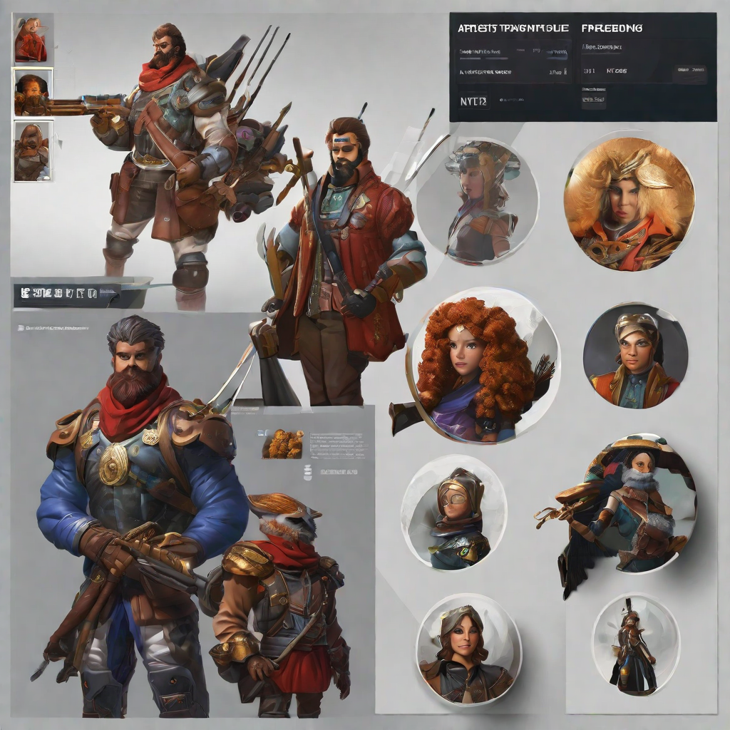
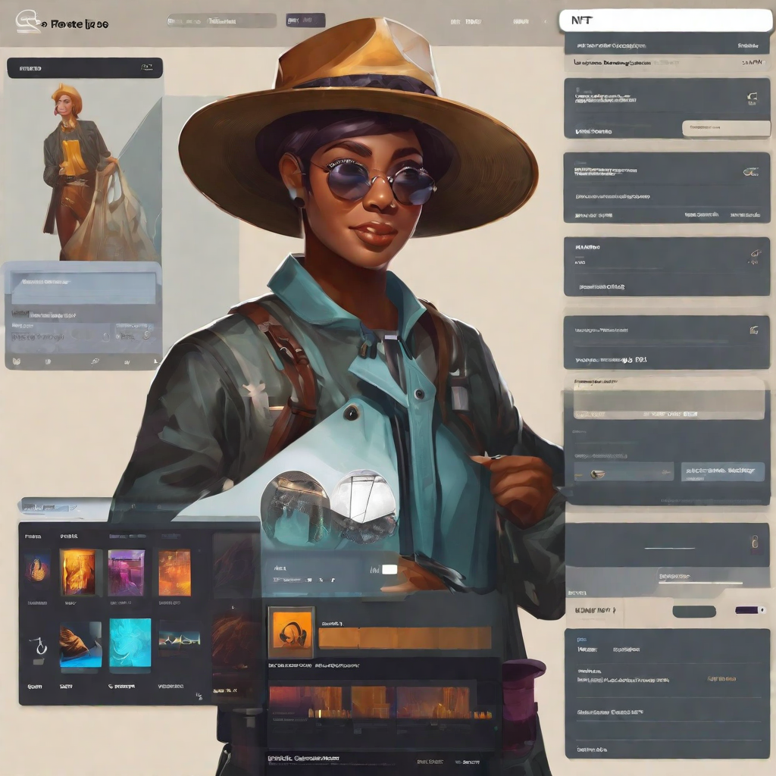
Features for Artists
Our NFT marketplace provides a range of features for artists to showcase and sell their work. Here are some of the key features:
Artist Profile Page
Artists can create and customize their own profile page on our marketplace. This page will feature their bio, profile picture, and portfolio of NFTs available for sale. This allows artists to showcase their work and build their brand on our platform.
Minting and Selling NFTs
Our marketplace allows artists to easily mint and sell their NFTs. This process is streamlined and user-friendly, making it easy for artists to get their work on our platform and start selling.
Royalties and Smart Contracts
Our marketplace uses smart contracts to ensure that artists receive a percentage of the sale price every time their NFT is sold on our platform. This provides a sustainable revenue stream for artists and ensures that they are fairly compensated for their work.
Note : These Features are yet to be implemented

Slide 17
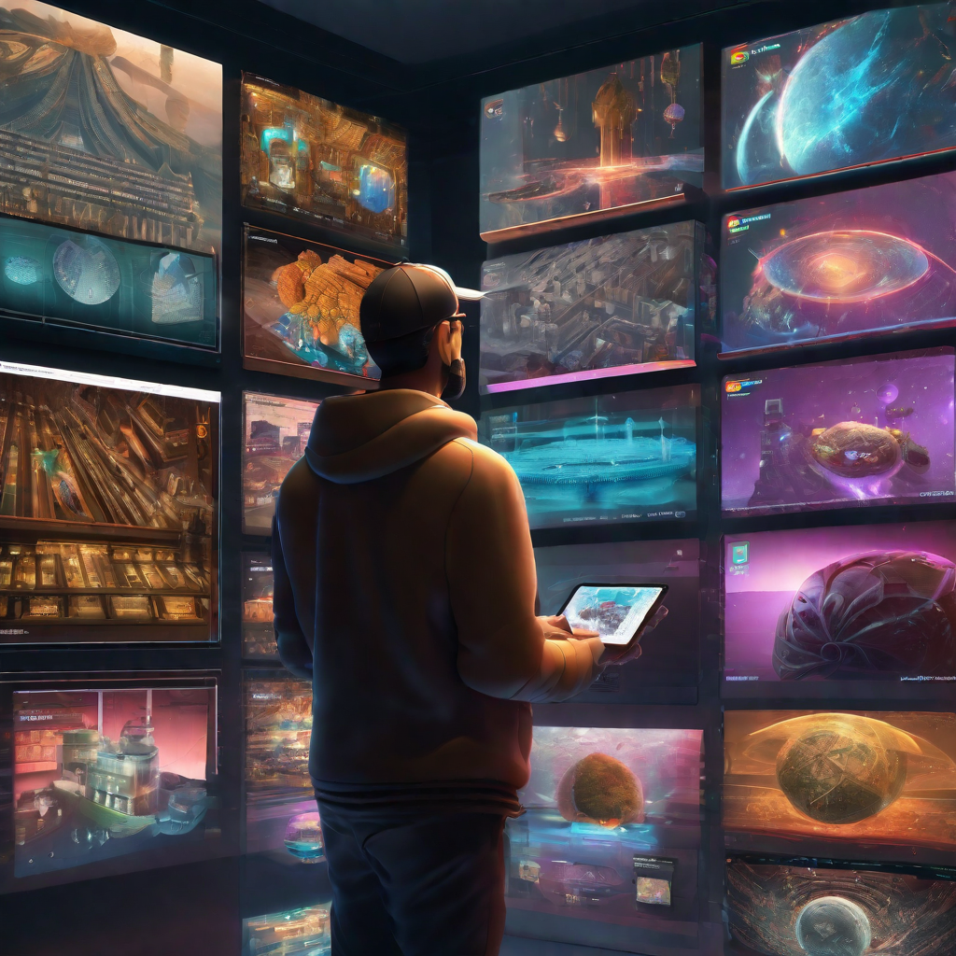
Features for Collectors
Ability to browse and search for unique NFTs in various categories such as art, music, sports, and more.
Secure and transparent transactions through the use of blockchain technology and smart contracts.
Access to detailed information about each NFT, including its history, ownership, and authenticity.
Ability to bid on and purchase NFTs using cryptocurrency.
Opportunity to participate in exclusive auctions and sales of limited edition NFTs.
Ability to showcase and share NFT collections with other collectors on the platform.

Slide 18
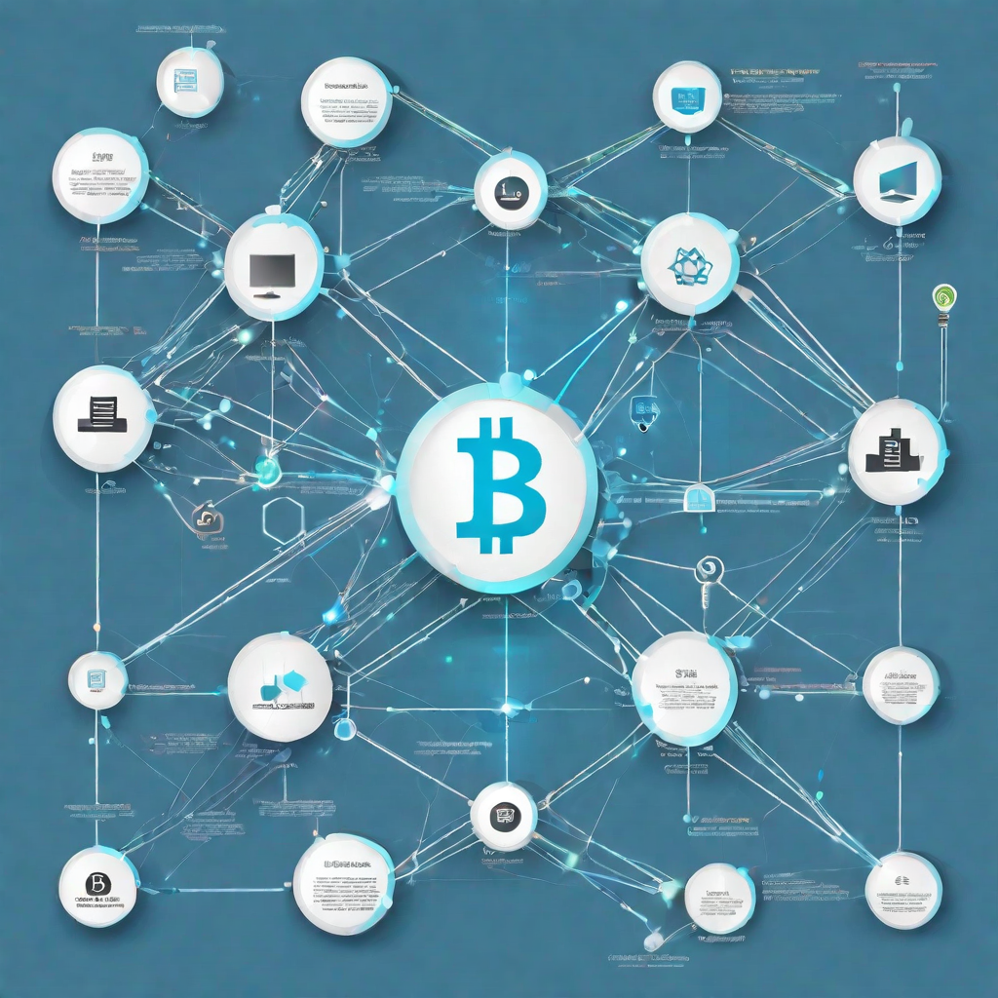
Security and Transparency on the Blockchain
The Blockchain network offers unparalleled security and transparency when it comes to transactions. This is due to the decentralized nature of the Blockchain, which means that there is no central authority or intermediary controlling the network. Instead, every participant in the network has a copy of the ledger, which is constantly updated and verified by all nodes in the network.
This means that any attempt to tamper with the ledger would require a majority of the network's computing power, making it virtually impossible to alter transactions without detection.
All transactions on the Blockchain are transparent and can be viewed by anyone on the network, ensuring complete accountability and trust between parties.
The use of smart contracts on the Blockchain ensures that transactions are executed automatically and without the need for intermediaries, reducing the risk of fraud and errors.
The immutable nature of the Blockchain ensures that all transactions are permanent and cannot be altered, providing a secure and reliable record of all transactions on the network.

Slide 19
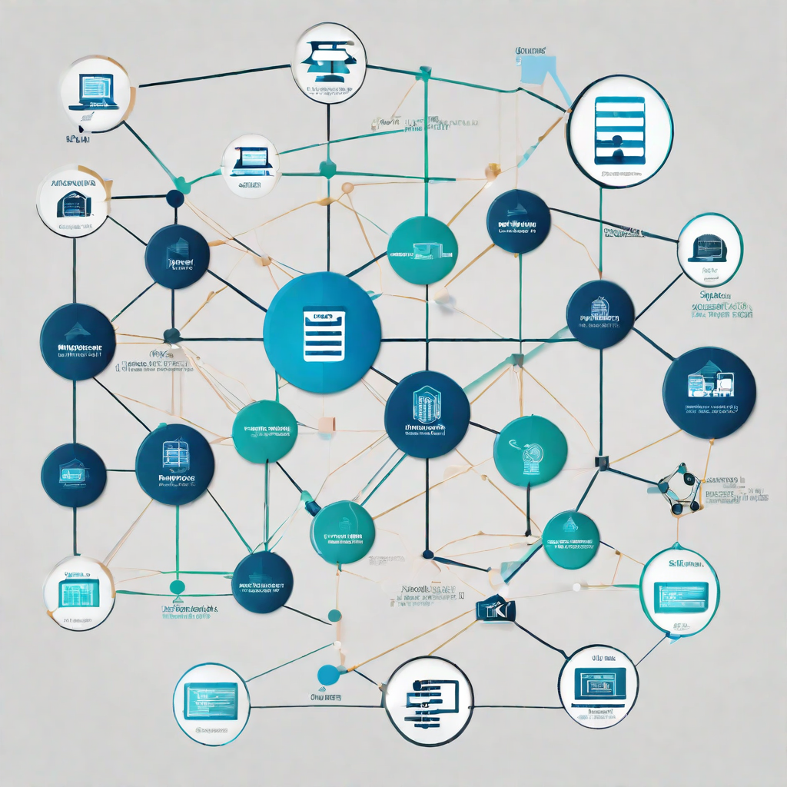
Our Unique Value Proposition
Our NFT marketplace offers a unique value proposition that sets us apart from other marketplaces. We use a blockchain network to ensure secure and transparent transactions for both buyers and sellers.
Secure Transactions
Our blockchain network ensures that all transactions are secure and tamper-proof. This provides peace of mind to both buyers and sellers, knowing that their transactions are protected from fraud and hacking attempts.
Transparent Transactions
Our blockchain network also provides transparency in transactions, allowing buyers and sellers to see the history of ownership and transaction details for each NFT. This ensures that all transactions are fair and transparent.

Slide 20
Future Work in NFT Marketplace using Blockchain
Potential of Blockchain Technology in NFT Marketplaces
Blockchain technology provides a secure and transparent way to store and transfer digital assets. In NFT marketplaces, blockchain can be used to ensure the authenticity and ownership of digital assets. This can help prevent fraud and increase trust in the marketplace.
Blockchain technology can also be used to create smart contracts that automate the transfer of ownership and payment for NFTs. This can streamline the process and reduce the need for intermediaries.
Future Work in NFT Marketplaces using Blockchain
The future work in NFT marketplaces using blockchain technology includes the development of new features and functionalities that leverage the benefits of blockchain. This includes the integration of decentralized finance (DeFi) protocols to enable peer-to-peer transactions and the use of smart contracts to automate the transfer of ownership and payment.
Another area of future work is the development of new use cases for NFTs. This includes the creation of NFTs for physical assets, such as real estate or art, and the use of NFTs in gaming and virtual worlds.

Slide 21
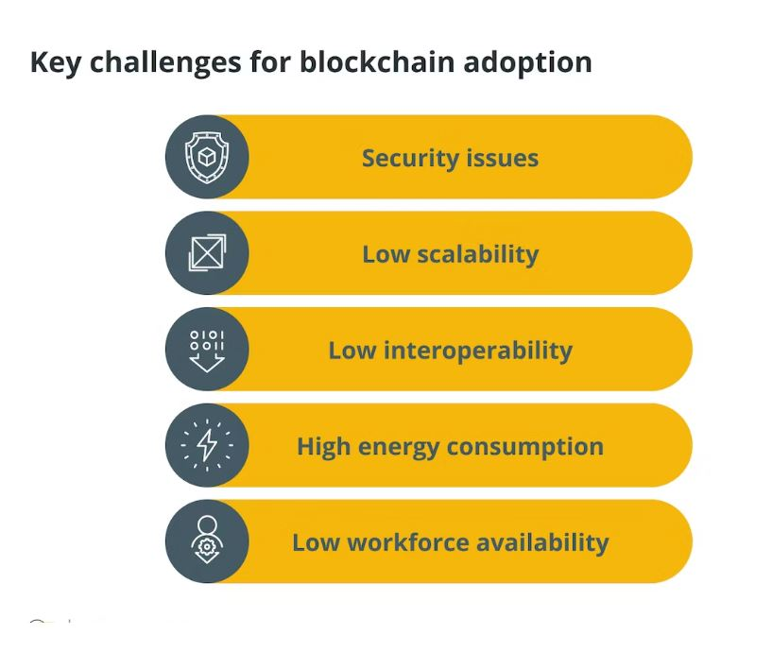
Challenges and Risks
Security Risks
The marketplace is highly susceptible to security risks such as hacking and data breaches. As the platform deals with high-value transactions, it is important to ensure that the security protocols are of the highest standards.
Regulatory Challenges
The regulatory environment for NFTs is still evolving, and there is a lack of clarity on how they will be treated by regulators. This could lead to legal challenges and uncertainty in the marketplace.

Slide 22
Limitations to the project
Third party application usage : Unavoidably, quite a lot of third party applications are being used , like the MetaMask Wallet, the Graph, to aid the project.
2. Minimal usage of Functionality : The contract doesn't allow the project to have exceed 40bits of code data.
3. Added features limitations : s
a. Recommendation System : A very basic format of recommendation system has been applied on our project.
b. Auction System : As mentioned earlier, the point of minimal usage of functionalities bounds us from
developing a proper heavy build auction system consisting of all possible functionalities,
although, the basic auction system has been done, keeping the terms of limitations.

Slide 23
Social Impact and Sustainability
Our NFT marketplace is not just a platform for buying and selling digital assets, it is also a platform for social impact and sustainability.
Social Impact
We support emerging artists and creators by providing them with a platform to showcase their work and reach a wider audience.
A portion of our profits goes towards supporting various charities and social causes that align with our values.
Sustainability
Our platform is built on a blockchain network, which allows for secure and transparent transactions without the need for intermediaries, reducing the carbon footprint of the marketplace.
We are committed to reducing our environmental impact by implementing sustainable practices in our operations and encouraging our users to do the same.

Slide 24
Conclusion
In conclusion, the use of blockchain technology in the NFT marketplace has revolutionized the way we think about digital ownership and provenance. With the ability to verify the authenticity and ownership of digital assets, the NFT marketplace has opened up new possibilities for creators, collectors, and investors alike.
As we move forward, it is important to continue exploring the potential of blockchain technology in the art world and beyond. By leveraging the transparency and security of blockchain, we can create new opportunities for collaboration and innovation that were previously impossible.
Thank you for your time and attention. We hope this presentation has provided valuable insights into the exciting world of NFTs and blockchain technology.
Project Link
https://github.com/sayak23082002/Final-Year-Project

Slide 25
Team and Advisors
Our team is composed of experienced blockchain developers, NFT enthusiasts, and marketing experts who are all passionate about revolutionizing the NFT marketplace. Here are some of our key team members and advisors:
Team Members
Arpan Basu (Roll No. 12200120044)
Sayak Karui (Roll No. 12200120023)
Soumyak Mitra (Roll No. 12200121065)
Anubhav Routh (Roll No. 12200121062)

Slide 26
Thank You

